Slide 1


Systems Market Visit
Lagos, Nigeria
COKE ROUTE
PnP VI > TBS > Divine Touch
Booklet WIP- Formatting and final checks ongoing till Friday

Slide 2
Coke Route
Start | Duration | End | Market Visit Itinerary | Time
09:30 | 0:40 | 10:00 | Transit from George Hotel | 09:30 - 10:00
10:00 | 1:00 | 11:00 | Visit at PnP VI | 10:00 - 11:00
11:30 | 0:40 | 12:10 | Visit at Divine Touch MDP | 11:30 – 12:10
12:30 | 0:50 | 13:20 | TBS FT Outlets | 12:30 – 13:20
14:00 | 0:30 | 14:30 | Debrief at George Hotel | 14:00 – 14:30
14:30 | 1:30 | 16:00 | Lunch | 14:30 – 16:00

Slide 3
Nigeria Overview: External conditions remain difficult, yet there are significant opportunities in the country, and we have reasons to believe
1
2
3
Despite challenging headwinds…
…there is significant potential/ headroom…
…and a strong reason to believe
2
1
3
1
1
+34.8%
Inflation rate
39.8%
Food inflation
232.7m
Population
~17.2yrs median age (FYE’23)
>50%
Teen/youth population
~1,800
No. of sales team with Best-in-class capabilities
~80%
Customer NPS (FY’24)
100% CTL & 61% R. Rate
+77%
Increase in PMS (Dec ‘24 vs Dec ‘23)
122.9%
Decline in Naira vs. USD (FYE’24, YoY change)
~29%
RTM Outlet coverage
(~67% covered through wholesales)
28.6%
Cooler Coverage vs. 46.7% average across CCH
109.3k
Onboarded Chatbot users (+97% vs PY Onboarding)
53.8%
SSD Value share
(+3.6pp vs PY)
33.4%
Unemployment rate
74
Industry SSD
Per Caps
(below CCH average of 141)
23.0%
Juice Value Share
261k
Indirect customers
(+27% Vs PY)
6,872
Direct customers
28.9Muc
Energy (+ 32 vs PY)

Slide 4
NIGERIA OVERVIEW
North
N/Central
West
L/Rural
Central
L/Mainland
L//Central
East
REGION/DEMAND AREA
VOLUME 2024
OUTLET COVERAGE
REGION/DEMAND AREA
VOLUME 2024
OUTLET COVERAGE
Lagos Mainland
30.7 Muc (7%)
29.4k (11%)
Central
78.6 Muc (18%)
52.1k (20%)
Lagos Central
33.3 Muc (8%)
29.7k (11%)
East
65.8 Muc (15%)
40.3k (15%)
West
49.4 Muc (11%)
26.5k (10%)
North
71.2 Muc (16%)
24.0k (9%)
Hinterland/Lagos Rural
28.3 Muc (6%)
20.9k (8%)
North Central
72.0 Muc (16%)
38.5k (15%)
KA/HORECA
22.9 Muc (5%)
3.2k (47%)

Slide 5
Nigerian Bottling Company

Slide 6
IN 2024 WE DELIVERED STRONG RESULTS
Volume
Penetration
NSR Fxn
Value Share
Outlet coverage
440.9 MUCs
+6.1% vs. PY
+7.2% vs. BP
43.2% ONS
+2.6pp vs. PY
+83.5% vs PY
53.8% MS
+3.6pp OCT’YTD vs. PY
261k
+55k no of outlets vs PY
+
+
+
+
IN 2025 WE HAVE STRONGER AMBITIONS
Volume
Penetration
NSR Fxn
RED ONS
Outlet coverage
479.4 MUCs
+8.7% vs. PY
54.2% ONS
+6.6pp vs. PY
+49.6% vs PY
58.4% ONS
+5.2pp vs. PY
320k
+59k no of outlets vs PY
+
+
+
+

Slide 7
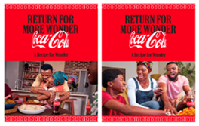
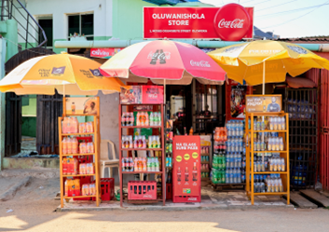
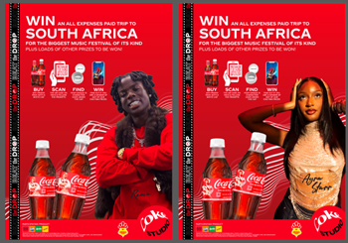
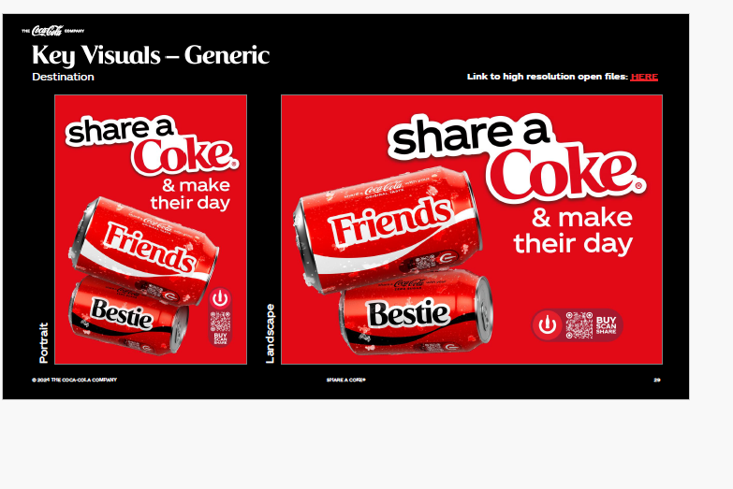
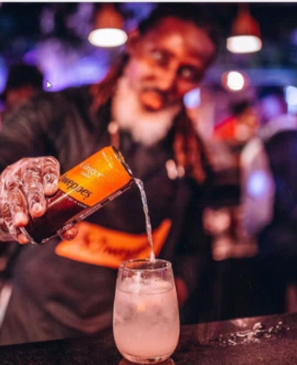
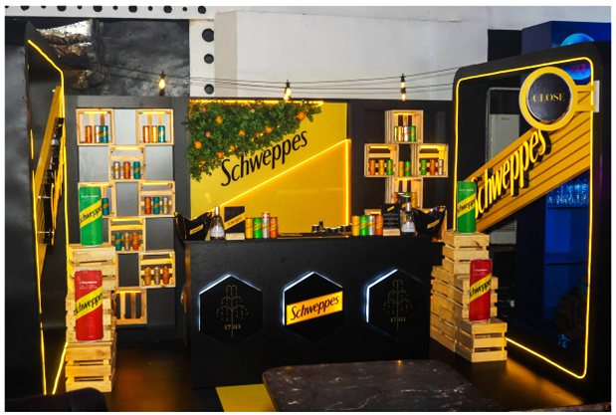
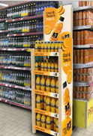
Marketing ⎸ We continue to leverage our campaigns to drive growth and expansion
Marketing initiatives
Accelerate Affordability leveraging RGB
Accelerate Frequency/Drive recruitment
Step-change Premiumisation
Leverage Always on Meals Campaign to drive frequency and weekly+
Magnify shopper communication on RGB
Step-change forward stock visibility with placement of 25k racks (+25% vs PY)
Upscale Breaks with Coke Studio
Launch Share a Coke
Drive CWM association in Supermarkets and QSRs
Step-change forward stock visibility with placement of 25k racks (+25% vs PY)
Step-up iconicity and brand voice, leveraging Born Social 2.0/Deliver focused brand building via HORECA
Improve Juice Delight profitability and edge
Leverage brand asset across relevant consumer touchpoints to drive recruitment on Monster .

Slide 8
Execution ⎸ In 2025, we will further improve both our sales efficiency and upscale our execution excellence.
RGM
Drive smart affordability and premiumization
Accelerate high NSR Mix
Accelerate Price & maintain relevance
Deliver quality Net Sales Revenue
Can acceleration +25% Vol vs PY
Schweppes 40cl PET Skittle Acceleration +279% vs PY
Juice +2% Vol vs PY
Increase trade margins & protect affordable packs
Headline pricing principle: 100% CPI coverage
Data-driven, Smart and agile decisions: Leveraging PVP/Conjoint for scenario planning
Maintain Aligned RGM 2.0 Refresh principles: Focused on Affordability and Premiumization for profitable growth
2024
2025 BP
2024
2025 BP
RTM
Maintain excellence in execution
Maintain quality execution
Accelerate Outlet Coverage
58.4%
65.1%
261k
320k
-12.7pp vs BP/flat to PY
+6.7pp vs PY
29% of universe
35% of universe ( +59k outlets, +23% Vs PY)
RED Index
RED Index
Outlet Coverage Universe
Outlet Coverage Universe
2024 there was a rebase from PACK to SKU
Accelerate Digital Commerce
Accelerate MDP via Chatbot
Step change Customer Portal
109K
150K
2.5k
3.2K
15% vs BP
+38% vs PY
+4% vs BP
+28% Vs PY
Registered customers
Registered customers
Monthly Active customers
Monthly Active customers
DIA
Enabled by DIA and CDE
Maintain strong segmented execution compliance
Accelerate delivery of profitable CDE coverage
57%
60%
70%
72%
+7pp vs. BP
+3pp vs. PY
+2 pp vs. BP
+2pp vs. PY
Suggested Order Compliance
Suggested Order Compliance
CDE Profitability
CDE Profitability
Supported by BIC Customer Management
Maintian BIC Customer Satisfaction (HBC top 3)
Expand survey coverage
80%
81%
166k
217k
+5pp vs BP
+1pp vs PY
+14% vs BP
+31% vs PY
NPS
NPS
Customer coverage
Customer coverage

Slide 9
Channel and MV Overview

Slide 10
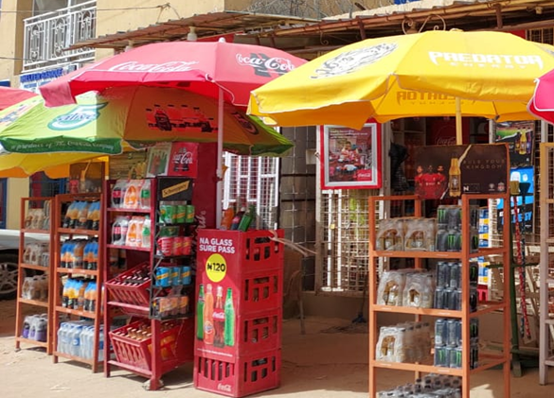
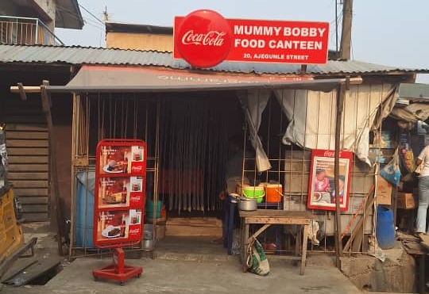
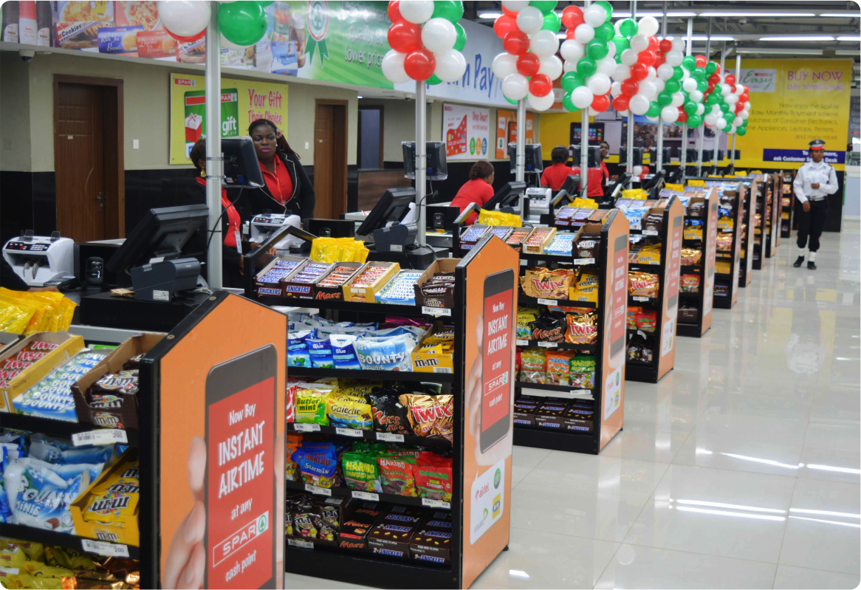
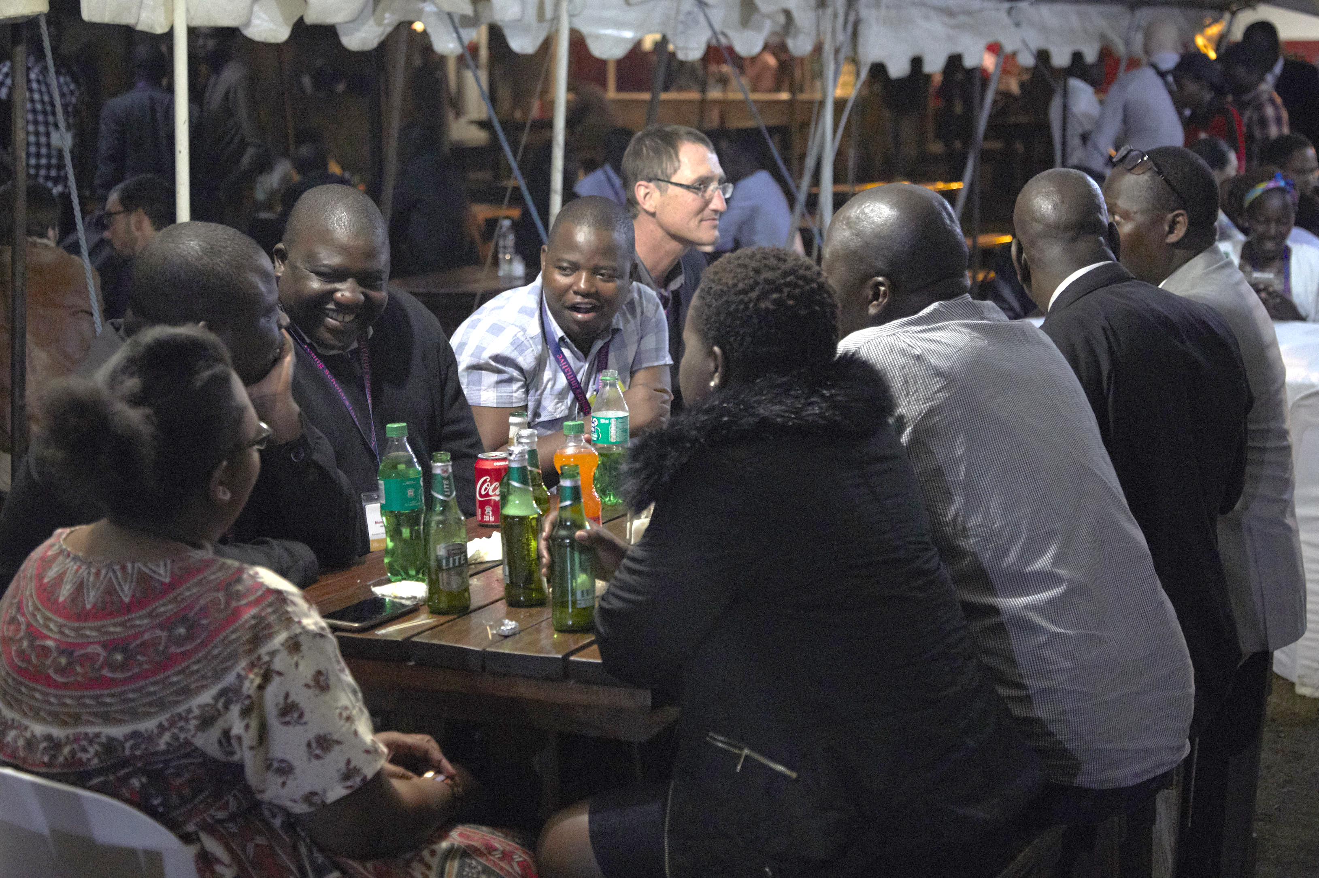
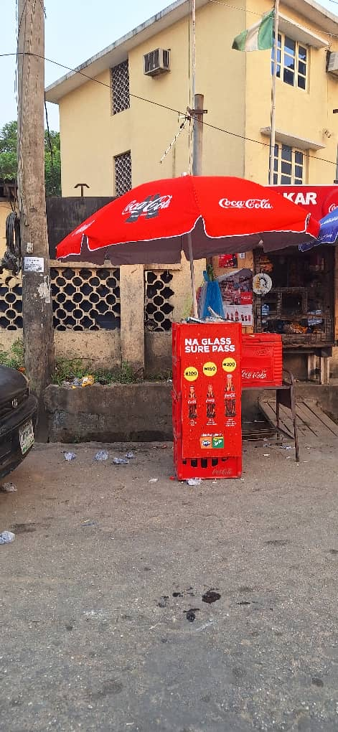
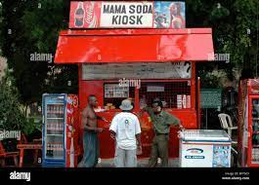
891.5K Nielsen Universe
Nigeria Retail Universe ⎸Highly skewed towards Fragmented Trade (Local & Traditional)
MV Focus
Mini-Shops (FT)
77% contribution (687k)
Bukas (FT)
8.4% contribution (75k)
Key Accounts (IC & FC)
1% contribution (4.5k)
Local Bars/ Pubs (FT)
8% contribution (72k)
Tabletops (FT)
1% contribution (11k)
Others (Open Market, Kiosks)
5% contribution(42K)

Slide 11
Nigeria Retail Universe ⎸Highly skewed towards Fragmented Trade (Local & Traditional)
Mini-Shops (FT)
77% contribution (687k)
Bukas (FT)
8% contribution (75k)
Super Markets (MT)
0.2% contribution (1.5k)
Overview: Mini shops are Local and Traditional unbranded superettes that are usually between 5 to 10 Square meters in size. Given the small size, the biggest challenge is OBM activation across categories
Occasions & hero packs: Mini shops are typically located in residential and commercial areas and as a result, they are the most relevant channel in Nigeria for both the “meals at home” and “Breaks” Occasions. The hero packs for this channel are: 50cl RGB and 50cl PET
2025 priorities:
Expand OBM activation to breaks in gold outlets and accelerate snacking activation at POS with new racks
Improve execution in Minishops by scaling racks placement (25K/25% vs. PY)
Leverage DIA/RTM capabilities to drive targeted visibility
Overview: Bukas are local & traditional restaurants/eateries and is the second most important fragmented trade channel.
Occasions & hero packs: The primary occasion in this channel is Meals AFH, as such, RGB is the critical hero pack for this channel.
Key insights: Buka restaurants often serve non-standard meals with plate size/ cost typically determined by the consumer who combines different items on a plate.
2025 Priorities:
Continue meals OBM activation and pilot new combo communications (flexible combo communications that considers non-standard plate size)
Accelerate RGB numeric distribution from 83% to 90% and RED score from 72% to 74
Overview: Supermarkets are one of the fastest growing channels given the size of opportunity to modernize everyday shopping in Nigeria. Leading Chain store players like ShopRite & Spar have been behind the growth in the past 10+ years. However, post COVID, local supermarket chains that have the advantage of smaller format type and proximity to neighborhoods, have started to emerge. Most Supermarkets have three major destination zones. The Fresh fruit, the Deli and the beverage or ambient zone.
Occasions & hero packs: The primary occasion is Meals AH, Breaks and Socializing and the hero pack is 50cl PET
2025 Priorities:
Accelerate Meals OBM communication by branding primary and secondary shelf spaces.
Drive tailored activation in local key accounts and neighborhood stores

Slide 12
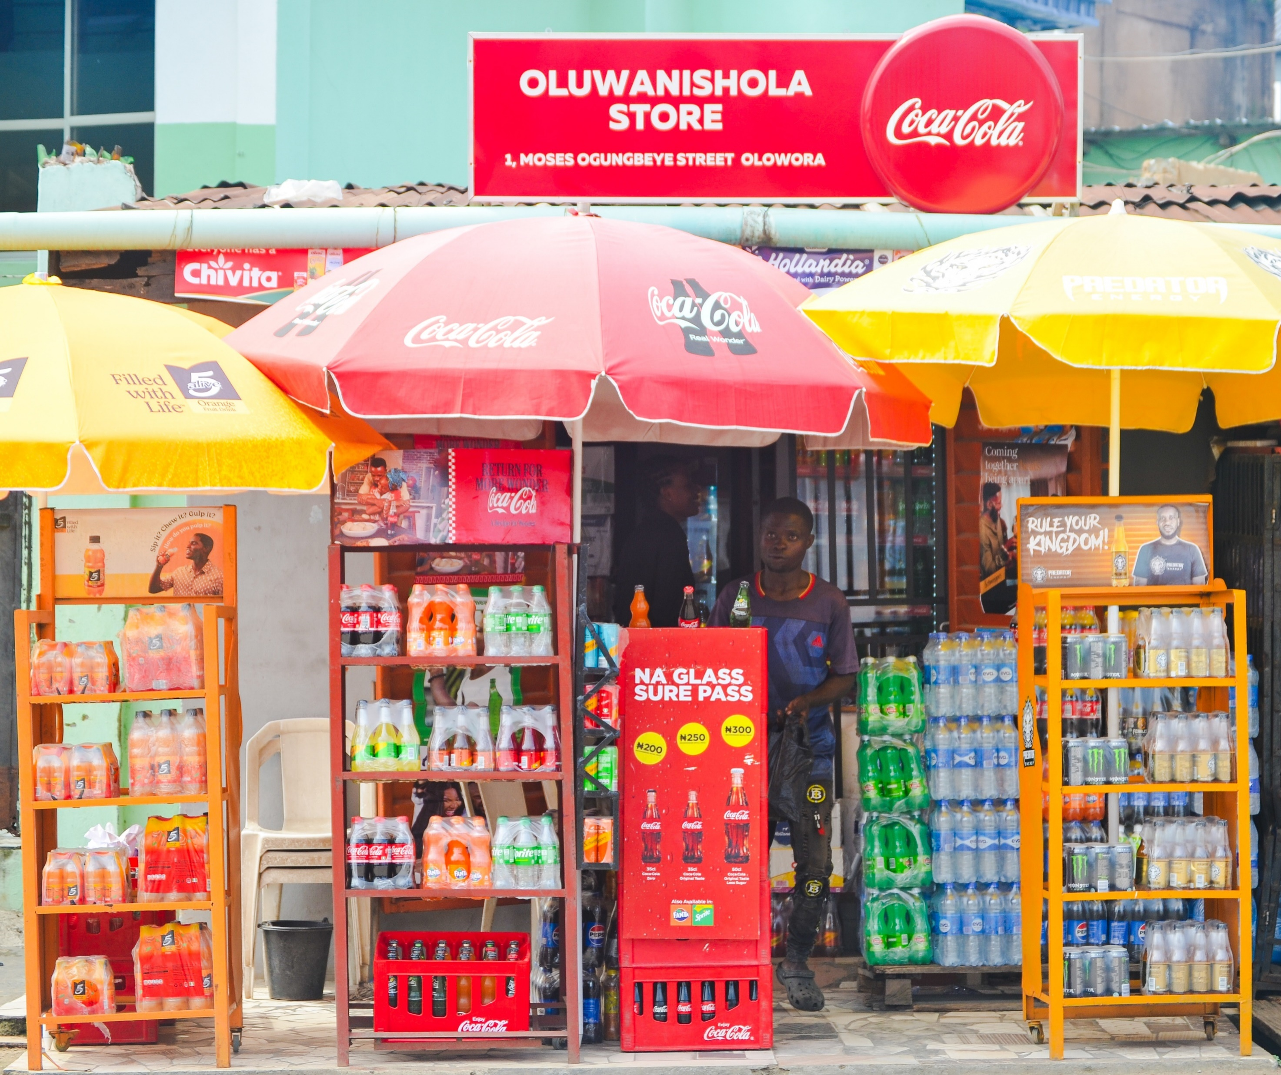
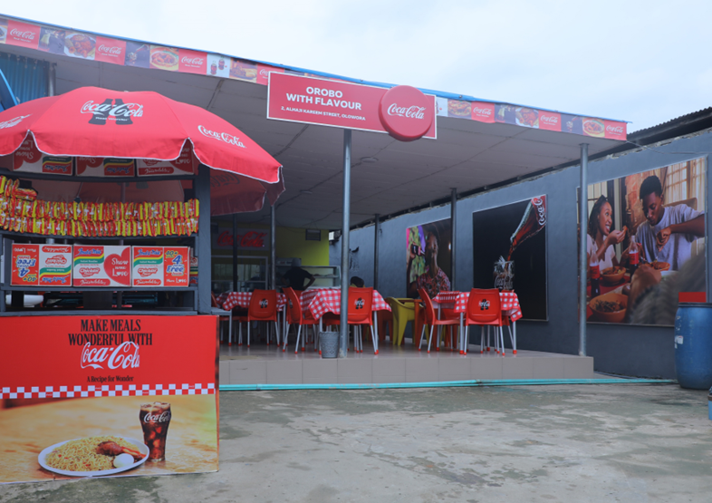
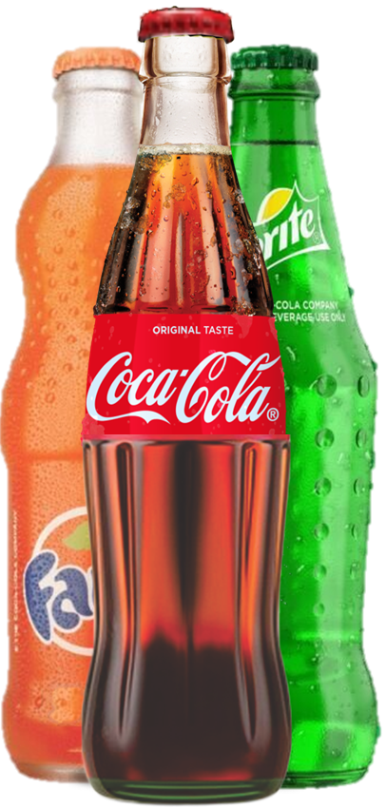
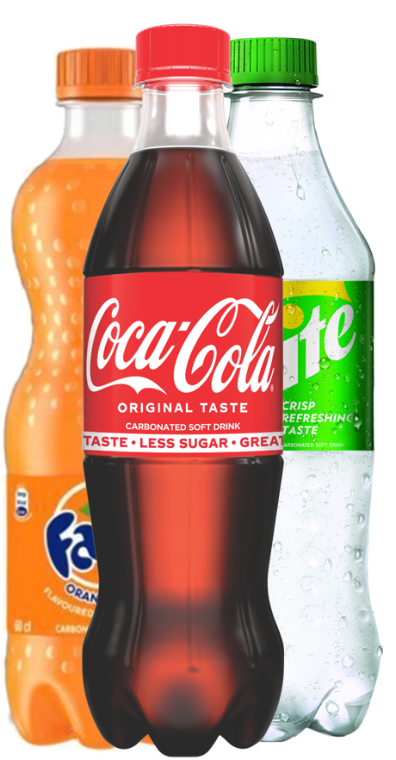
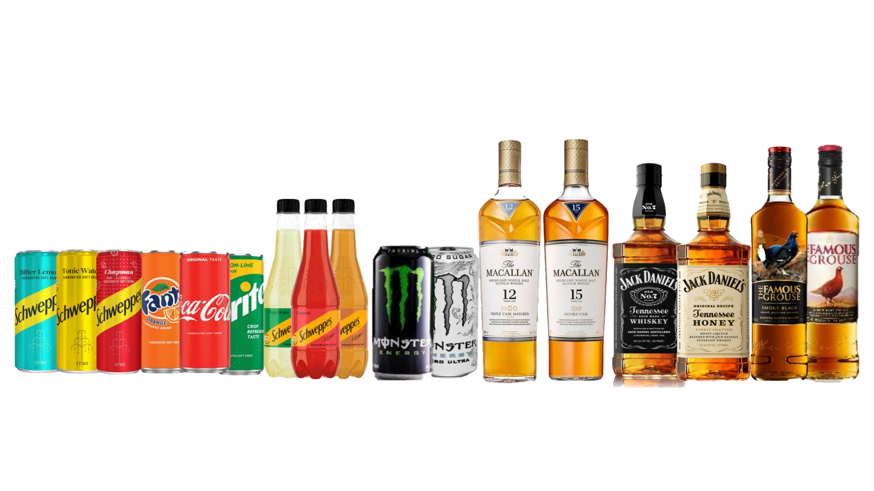
Role of Priority Packs within Key Channels
 | Minishops | Bukas | Supermarket
35cl RGB (CFS)
Plays the role of recruitment pack
Plays the role of affordable IC entry pack
N/A
Plays the role of recruitment pack within channel. Used as a party pack
35cl PET (CFS)
Plays the role of recruitment pack
Plays the role of IC entry pack. Also leveraged for Combo activation
Hero pack within channel driving repeat consumption among Weekly+ consumers.
Frequency pack, driving repeat consumption among Weekly+ consumers. Also serves as an Affordable IC pack driving recruitment.
N/A
50cl RGB (CFS)
50cl PET (CFS)
Frequency pack, driving repeat consumption among Weekly+
Frequency pack, driving repeat consumption among Weekly+
Frequency pack within channel
40cl Skittle
Serves as an Upscale pack
Serves as an Upscale IC pack
Serves as an Upscale pack

Slide 13
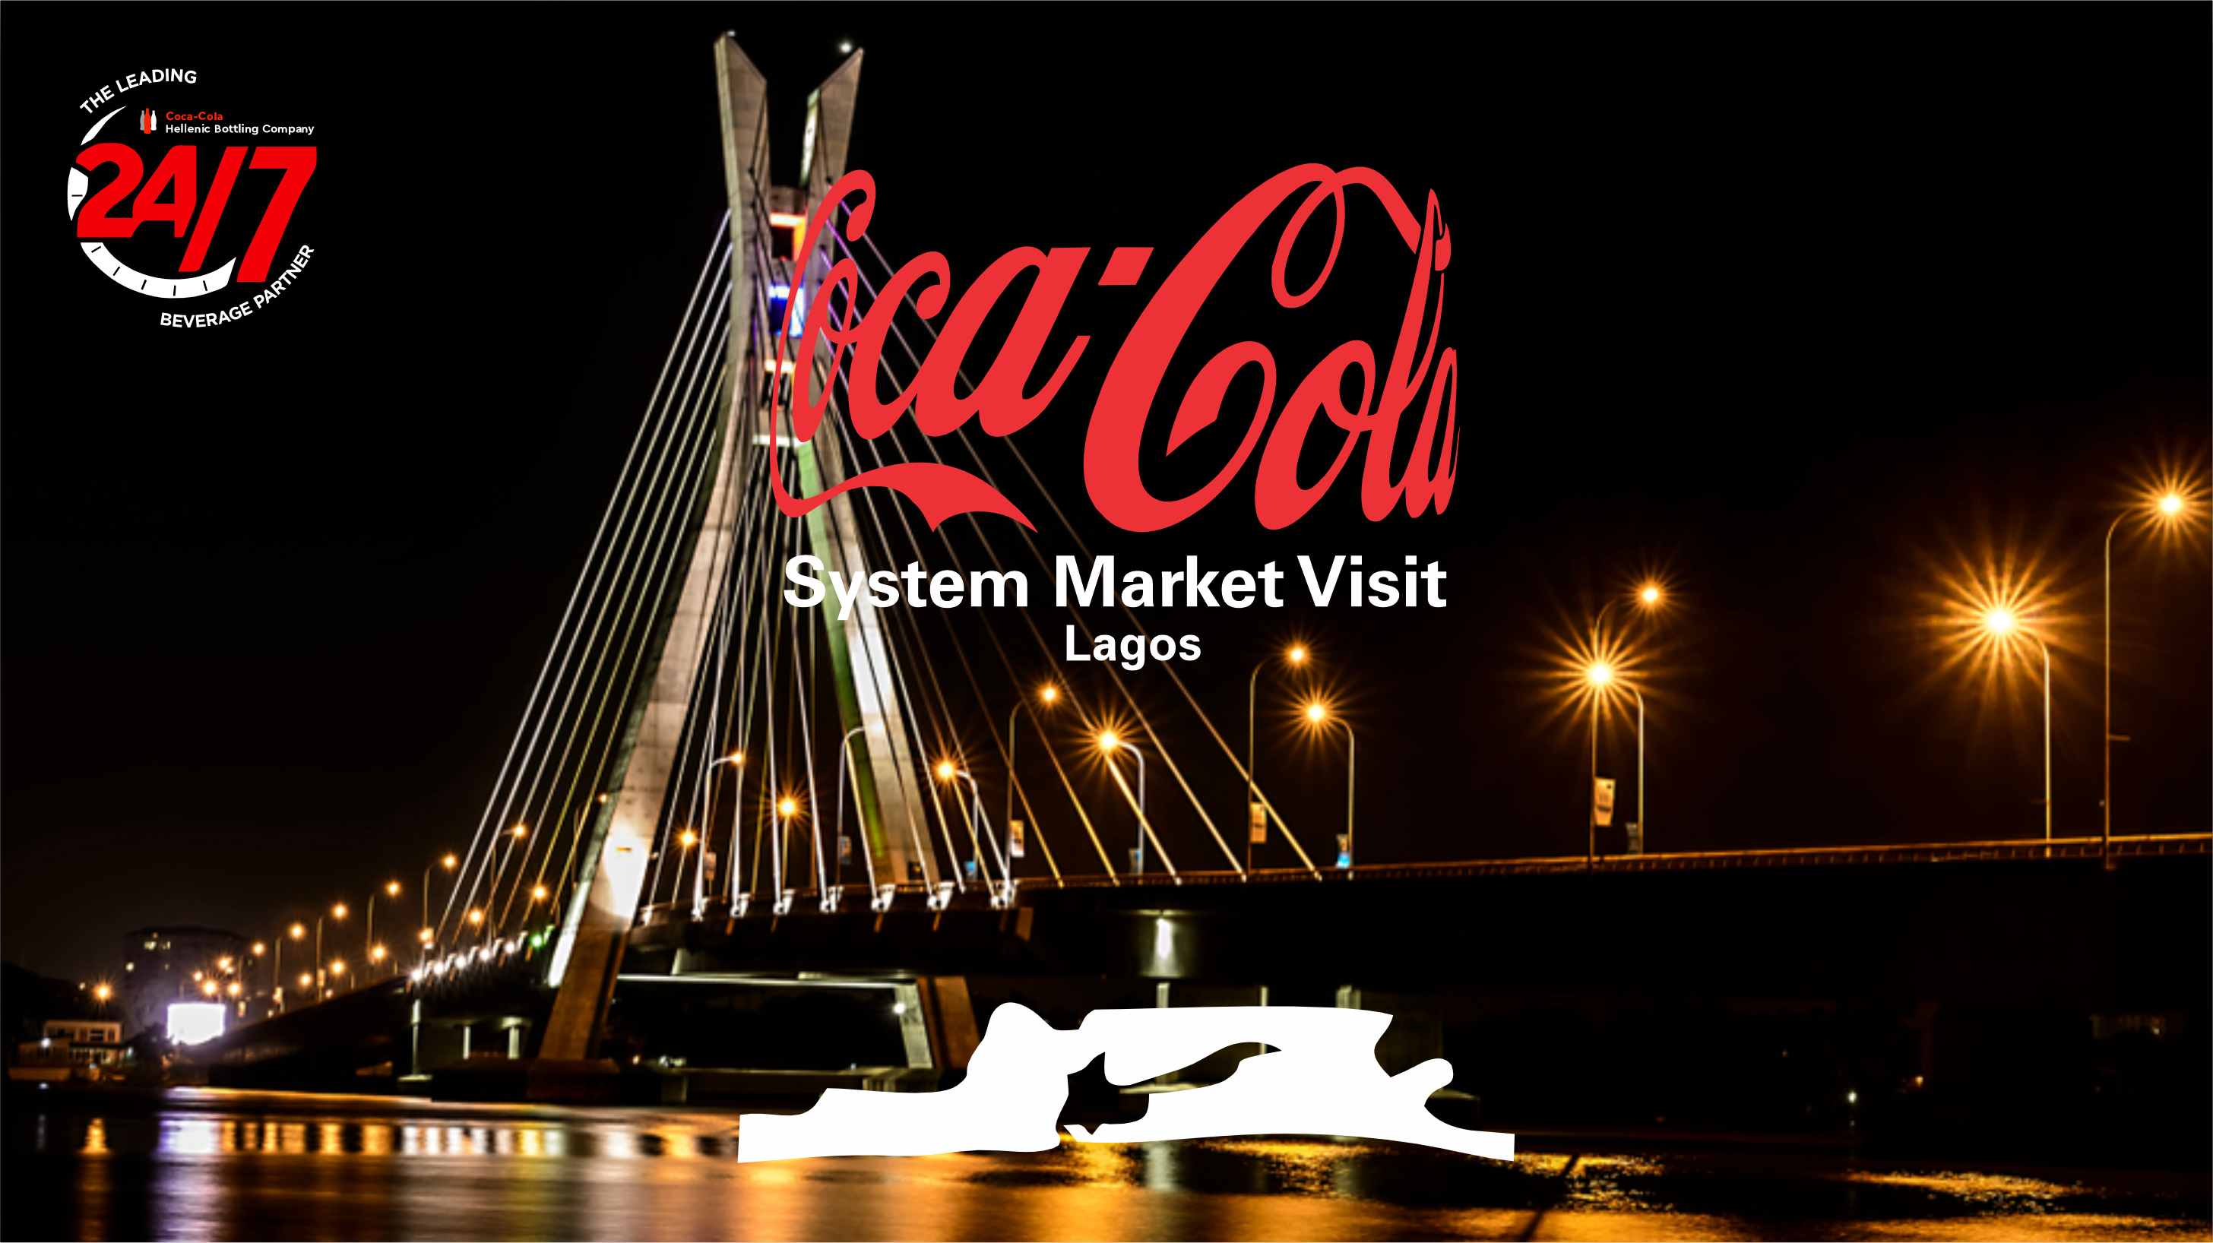
MARKET VISIT STORES

Slide 14
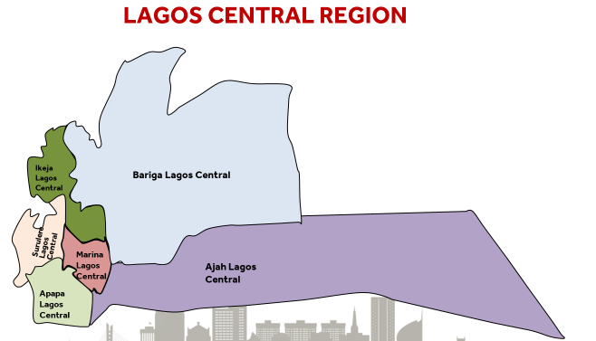
LAGOS CENTRAL REGION
Sales Team
Customers
273
224
29,368
319
Total
BDs
Indirect
Direct
CDE (12.8K)
Trade Execution
99%
99%
75%
62%
58.1%
77
Scanning
Data
Download
CDE
Profitability
SOC
Unforgivables
NPS
Located in the Eastern side of Lagos, Nigeria.
Home to the 5th busiest seaport in West Africa (Lagos Seaport, Apapa).
Lagos Central Sales region developed in 2015 from the previous Lagos Region due to high population density and urbanization.
Lagos Central Team, known as the “Warriors of Lagos,” are recognized for resilience, passion, accountability, and respect.
RED Index (61.4%)
SSD Market
Share
52.1%
72.5%
24.6%
Availability
Cold
Activation

Slide 15
Market Visit Routes
9.30am
11.00am
12.10pm
2.00pm
Depart George Hotel
Arrive PnP VI
Arrive MDP
Arrive 1st
Retail Outlet
Coke route
Transit
PnP VI Market visit
MDP Visit
Retail Outlets visit
Visit de-brief
SN | Names | Title | BU
1 | Zoran Bogdanovic | CEO | CCH
2 | Naya Kalogeraki | COO | CCH
3 | Luisa Ortega | AOU President | TCCC
4 | Ahmed Rady | VP | TCCC
5 | Goran Sladic | GM Nigeria | CCH
6 | Mariam Khan | GM, TCCC NG | TCCC
7 | Anastasis Stamoulis | CFO | CCH
8 | Herbert Bauer | CCHGM Austria | CCH
9 | Dora Strezova-Nikolova | GM Adria (Bosnia, Croatia, Slovenia) | CCH
10 | Vladimir Kosijer | R3 Director | CCH
11 | Mario Garcia | VP | TCCC
12 | Alex Kavasilas | VP Finance | TCCC
13 | Adriana Knackfuss | VP Marketing | TCCC
14 | Chris Christodoulakis | Sales Director Nigeria | CCH
15 | Soji Awotiwon | Senior Director, Franchise Operations | TCC
16 | Tolu Agosun | Regional Sales Director(Lagos Central) | CCH
17 | Abdulbasit Qureshi | Snacks & Coffee Business Manager | CCH

Slide 16

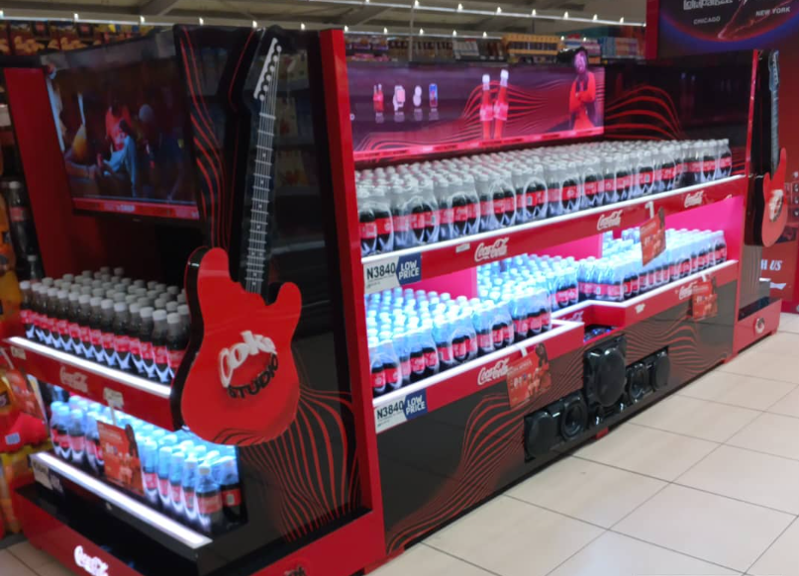
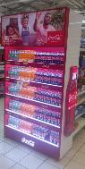
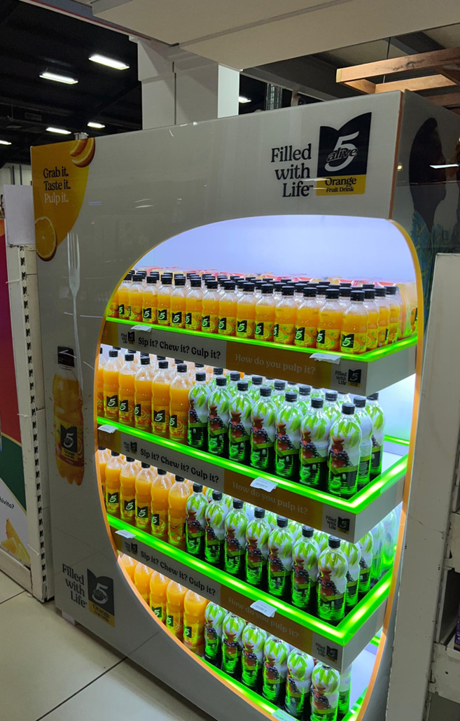
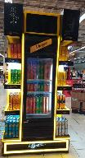
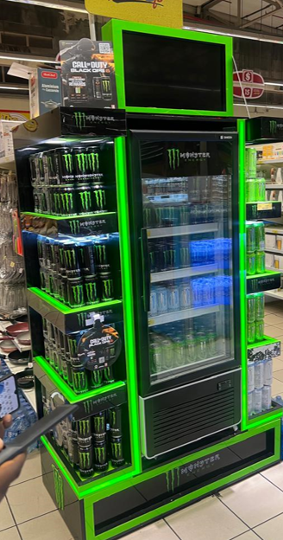
Pick and Pay VI
CUSTOMER OVERVIEW
Pick n pay is an international modern retail chain that has been in existence for over 5 years within Nigeria. A one stop shopping destination for groceries and household items.
Shoppers – High earning urban professionals.
Shopping Mission – Mostly Stock up
Nigeria Outlet Coverage - 2 stores
Pricing strategy– EDLP
Average daily footfall per outlet - 450
Competitor Analysis
Key Competitors: Shoprite, Spar, LKA
Unique Selling Proposition (USP):
Specialised activations
Enhanced customer shopping experience
Shop-in-shop concept (Meals, Butchery and Coffee)
FULL YEAR ‘24 Performance
Vol – 85.7K UC (+ xx% vs PY)
NSR: Naira (Euro) +% vs PY
VI Outlet
Vol – 47 KUC
NSR: Naira (Euro) +% vs PY
RED Execution
Points of Interruption ; xx
Displays : xx
Cooler Quality; 100%
RED Index : 91%
Update NSR
Key Priorities
Recruiting with Uplift occasion, leveraging Coke Studio and Coke with meals activation.
Premiumization with Schweppes, Energy, Premium Spirit and Juice.
Experiential execution across CCH Portfolio.

Slide 17
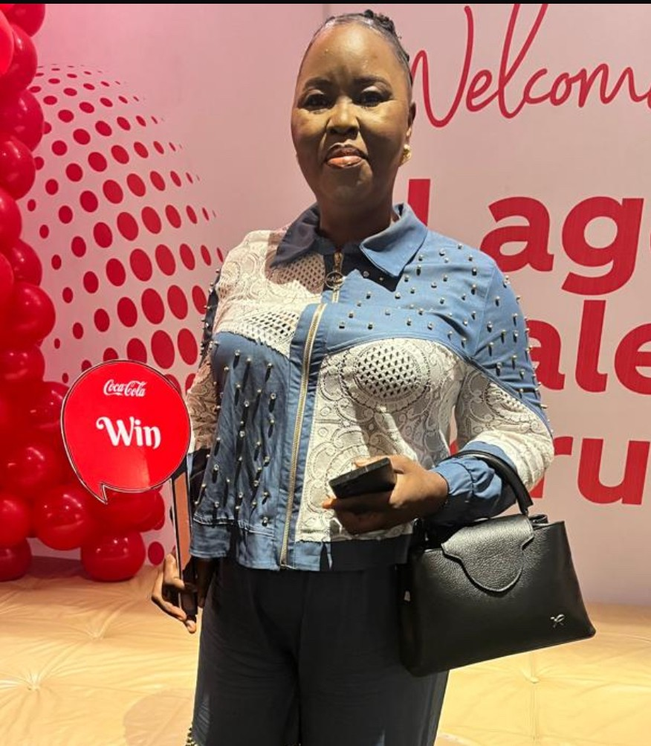

DIVINE TOUCH MDP
MDP OVERVIEW
RESOURCE
Years in Business: 22 Years
Staff Strength: 16
Growth Rate vs LY: 18% physical and 15% Unit growth over PY
Avg. Monthly Volume: 50KPhC
Revenue : 11,583 Euros +54% vs PY
Number of Business Developers: 4 (Four)
Number of Trucks: 4 (Four)
Warehouse Capacity: 925sqm / 60K cases
CM: ODUKOYA OMONIYI
DM: MERCY JEMIKALAJAH
Note: Briefing on RTM Process, starting off in the HGMM Room.
Mrs Bola Adegbami
MDP Operator
MDP OUTLET PROFILE
AREA CONSUMER PROFILE
EXECUTION NUMBERS
Coverage in Trade: 666
IKOYI: A & B
Red Strike Rate: 80%
P&L: Dealer Profitability = 8 mil Avg.
Dolphin , Osbourne: A, B & C,
Red Index: 54%
MDP YTD: 53kUC
Obalende, Sura, TBS: A,B, C, D and E
CDE Scanning: 100%
3 Big Bets:
Affordability: RGB vol mix of 10% and growth of 113%.vs PY
DOSA: 100%
Premiumization: Schweppes Vol. mix of 3% and growth of 321% vs PY
DIA/ SOC: 58%
Focus SKU: RGB to drive affordability
Frequency Pack: PET50 Vol mix of 52% and growth of 4%.
Unforgivable Penetration: 15 SKUs
Notes:
Change to Daytona and Divine touch

Slide 18
Coke Route| Fragmented Trade ⎸Retail Outlets
s/n | Outlet Name | Outlet Type | Segment | Red score | Weekly Volume | NPS
1 | PRINCESS STORE | Minishop | Gold Premium | 81.5% | 28 | 10
2 | TAWAKALITU VENTURES | Minishop | Silver Affordable | 63% | 14 | Not suitable for device
3 | GHANA HIGH RESTAURANT | Buka | Gold Premium | 74.5% | 75 | 10
4 | MAMA NGOZI STORES | Minishop | Silver Affordable | 64.4% | 11 | 9
5 | FUNMSY BAR | Wine & Liquor | Silver Affordable | 88% | 12 | 9
6 | IBUKUNOLUWA STORE | Minishop | Silver Affordable | 66.7% | 13 | 9
7 | ADELE STORES | Minishop | Gold Affordable | 63.5% | 20 | 8
8 | TOYIN FOODS | Buka | silver Affordable | 80.9% | 13 | 9
9 | JOMMY VARIETIES STORE | Minishop | Silver Affordable | 66.5% | 12 | Not suitable for device
10 | BOLA CHEMIST | Drug store | Silver Affordable | 63.5% | 10 | No response
11 | LADOSKIN STORES | Minishop | Gold Affordable | 80% | 30 | 9
12 | FAVOUR STORES | Minishop | Gold Affordable | 86.2% | 65 | 10
13 | FISTO STORES | Wine & Liquor | Silver Affordable | 65.7% | 9 | 10
14 | IGOHDINO STORES | Minishop | Gold Affordable | 82.1% | 100 | 9
15 | IYA EBA FOOD CATEEN | Buka | Gold Affordable | 54.6% | 85 | 10

Slide 19
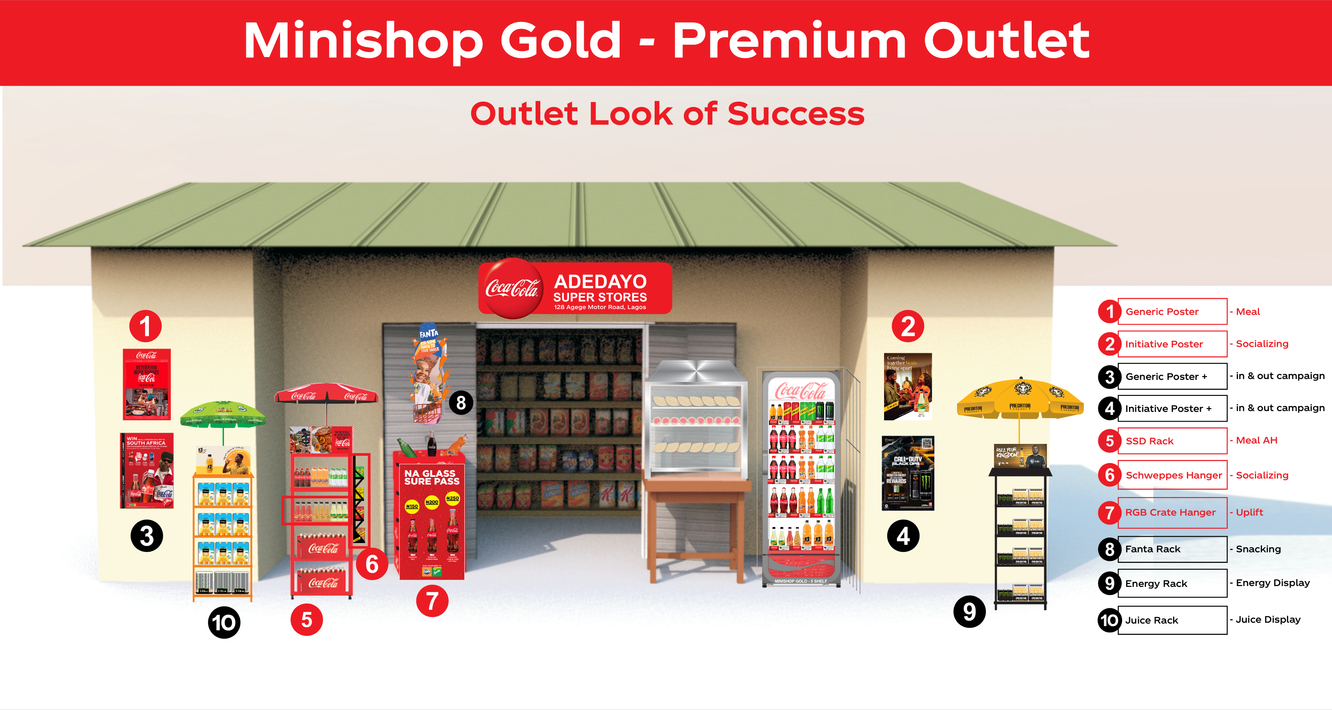
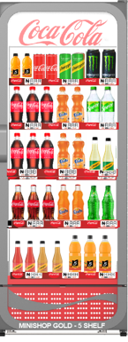

Slide 20
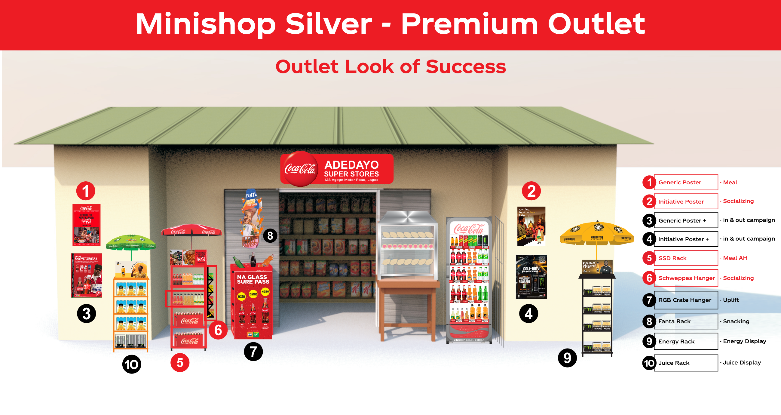

Slide 21
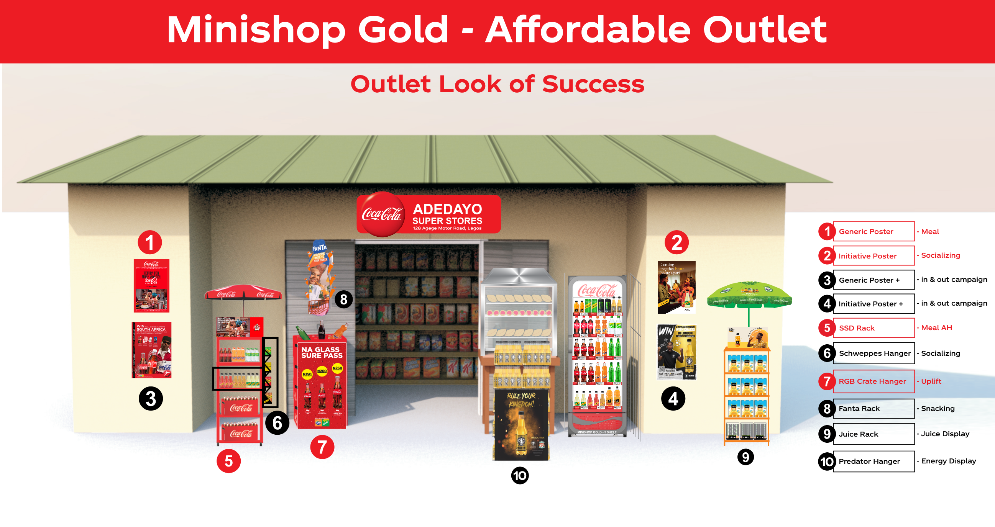
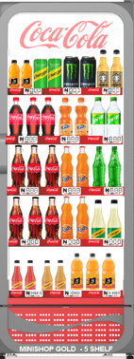

Slide 22
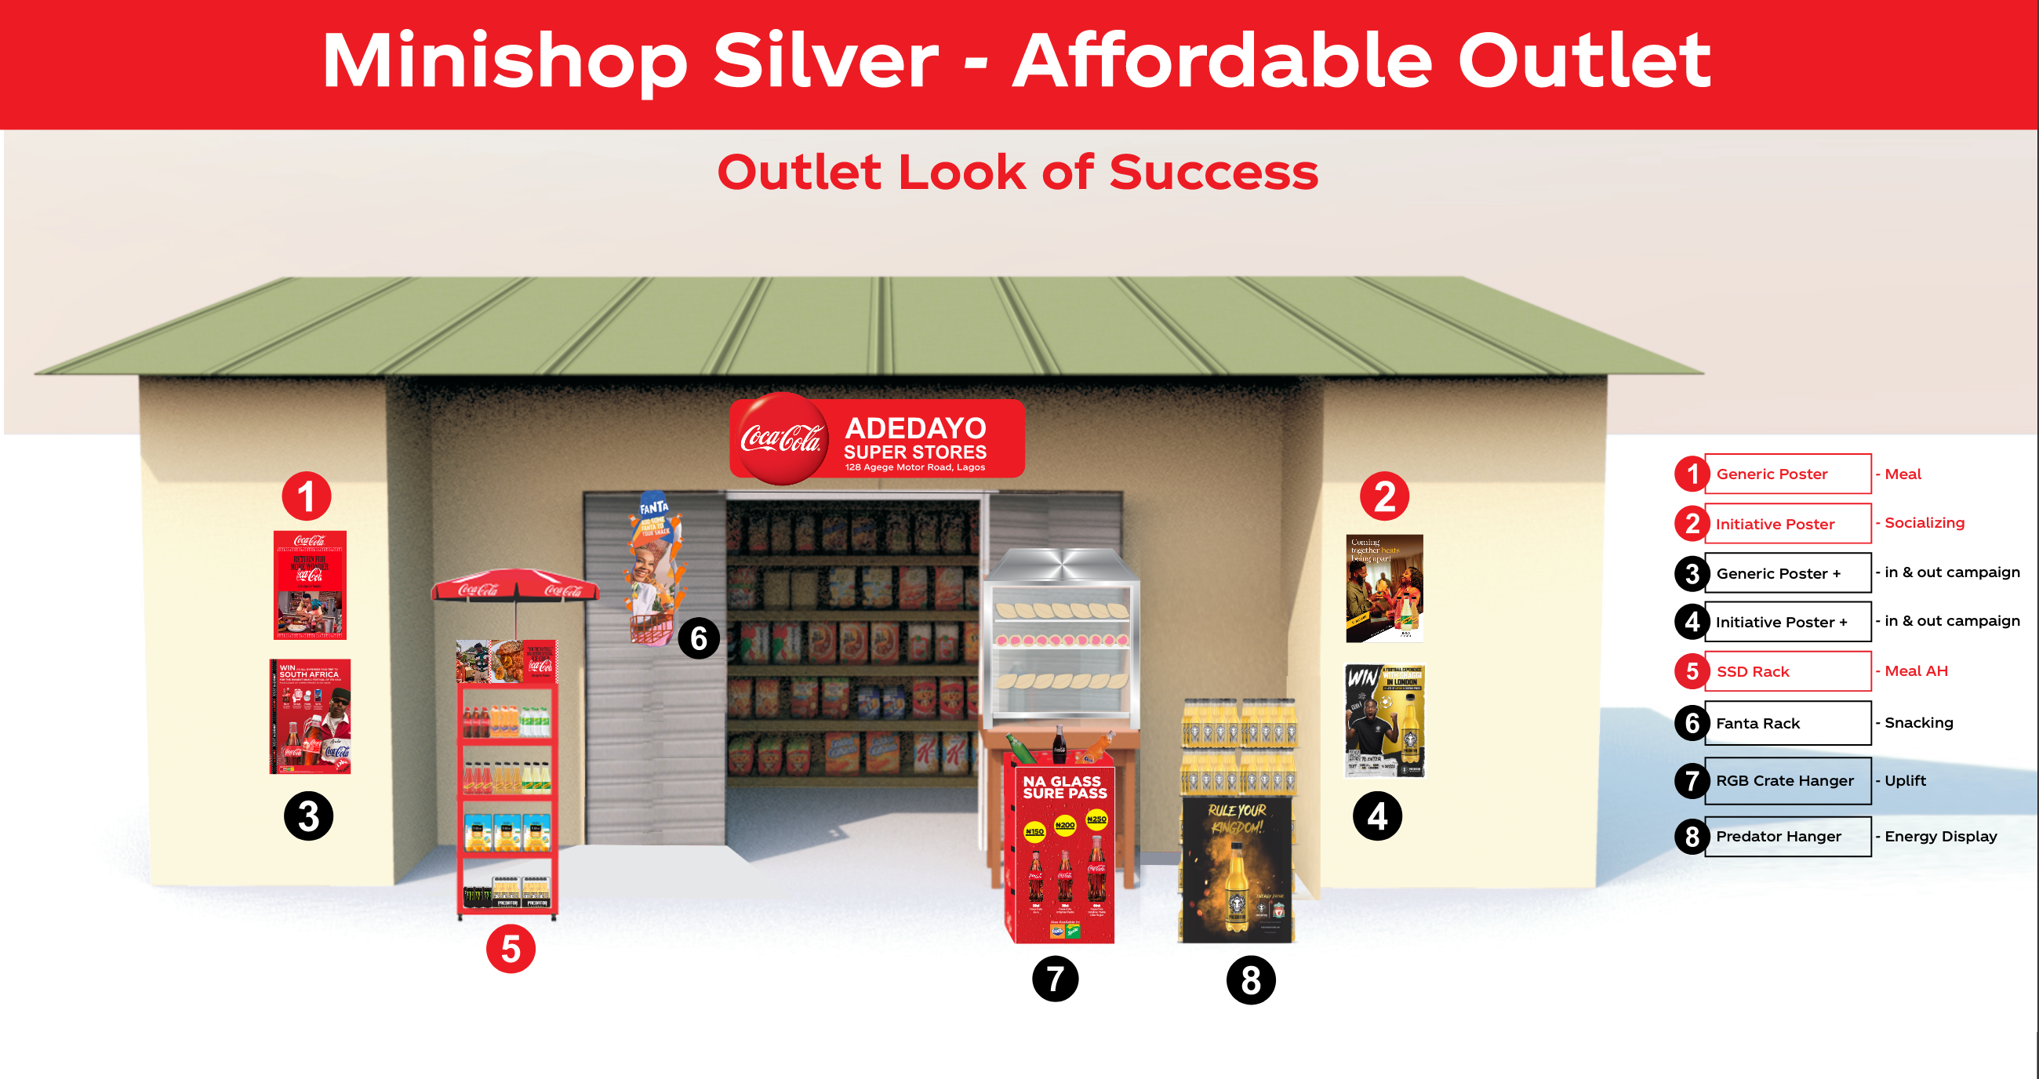

Slide 23


